Slide 1
GRI North-West Meeting
State of play and (future) functionalities of the PRISMA capacity platform
27 November 2013

Slide 2
After only 1 year the early CAM implementation¹ by PRISMA started successfully on 1 April 2013…
Platform go-live step by step. From idea to launch in less than a year.
20 Feb 2013
1 Apr 2013
15 Apr 2013
6 May 2013
Registration start
First DA auctions
First monthly auctions
First yearly auctions
Registration start for shippers in order to prepare April 1st
Application of the uniform-price auction algorithm
Application of the ascending-clock auction algorithm
Application of the ascending-clock auction algorithm
1 – Early implementation of CAM NC was asked and encouraged by ACER and European Commission

Slide 3
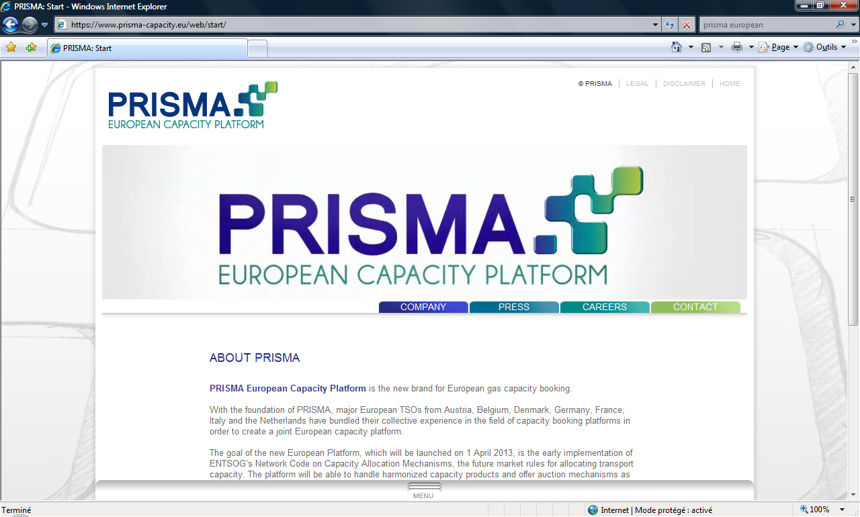
PRISMA has implemented almost all of the NC CAM requirements. Two years ahead of time.
www.prisma-capacity.eu
Capacity products
  Bundled products between hubs
  Unbundled products
  Products as defined in the CAM Network code
  Firm & Interruptible
All products available on one platform:
PRISMA European Capacity Platform
Allocation – Auction mechanisms as described in
the NC CAM
    Uniform price auction: day-ahead products
    Ascending clock algorithm: monthly, quarterly and yearly products
  The platform can also handle regional specificities, ensuring that European TSOs comply with their national regulation until NC CAM comes into force.

Slide 4

Beyond the future European requirements, PRISMA also provides additional services to TSOs and Shippers…
Centralised shipper and user registration on the platform
First-come-first-served booking at domestic points
Surrender of capacity
Conversion of interruptible into firm capacity
Multiple kinds of firm capacity, multiple interruptible levels
Competing capacity
1:n bundling
Credit limit check
Booking assignment to balancing groups and portfolios
Automated interface to deal capturing systems of shippers
Comfort functions for automated bidding
With a high number of state-of-the-art functionalities, the PRISMA platform provides an advanced way to fulfil the EU requirements.

Slide 5


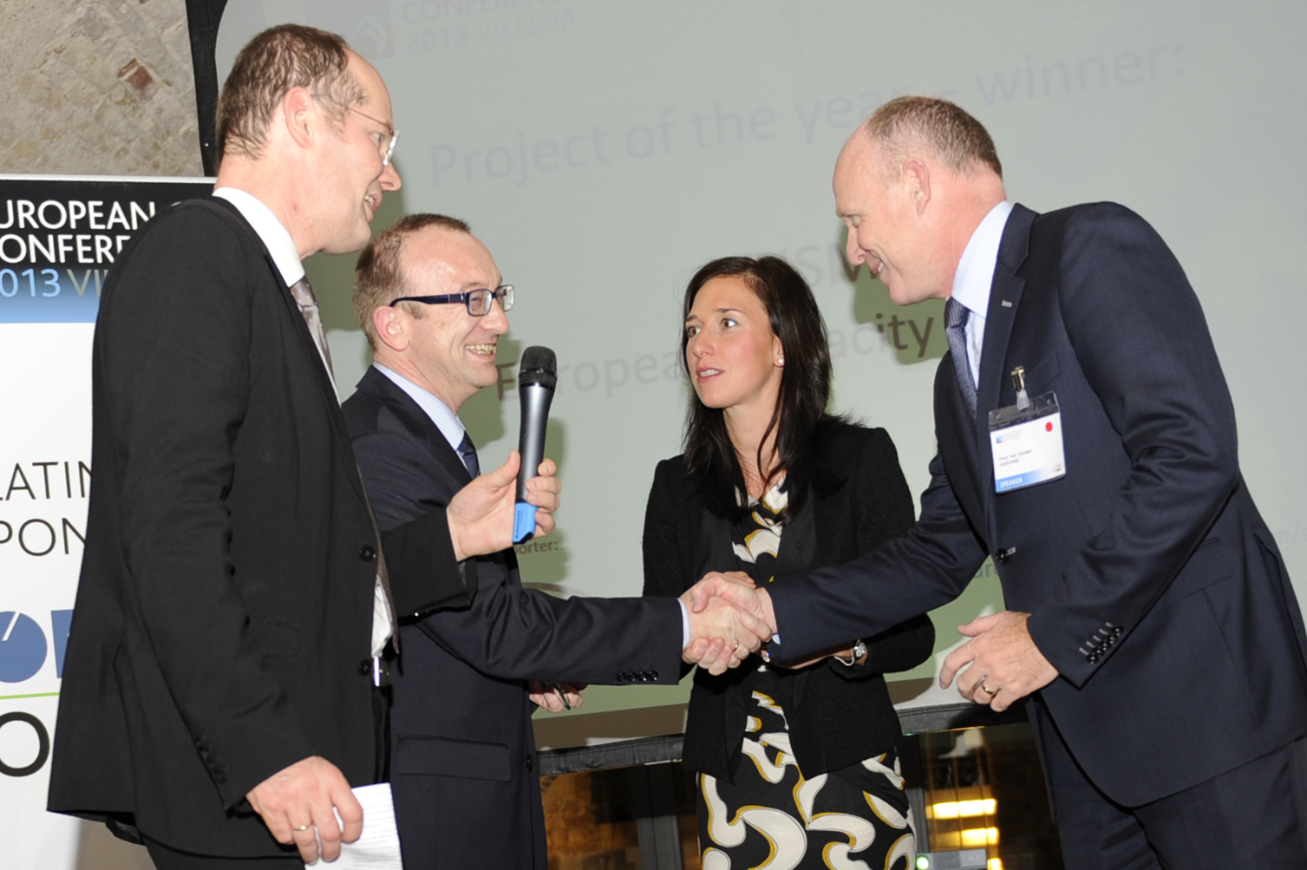
PRISMA has already reached significant acceptance and utilization in the market.
303 shippers with more than 900 users are using the platform to book transport capacity across European borders.
More than 28,000 auctions have taken place since the platform start
PRISMA held a public consultation on the platform functionalities and new GT&Cs. The public consultation ended on 16 September 2013 and an evaluation is currently being prepared. The evaluation will be published in Mid December along with the final version of the new GTCs.
The majority of the European shippers are using PRISMA daily to buy capacity.

Slide 6
Since PRISMA’s start, platform operations have been secure & stable with a large number of auctions taking place…
Capacity Auction Results:
  Yearly Capacity (243 auctions):
  Offered: 571.3 GWh/h/y
  Allocated: 172.2 GWh/h/y
  Quarterly Capacity (364 auctions):
  Offered: 932.4 GWh/h/q
  Allocated: 21.0 GWh/h/q
  Month-Ahead Capacity (587 auctions):
  Offered: 1,474.6 GWh/h/m
  Allocated: 37.9 GWh/h/m
  Day-Ahead Capacity (26,883 auctions):
  Offered: 53,563.1 GWh/h/d
  Allocated: 1,328.0 GWh/h/d

Slide 7
Current discussion with TSOs
Our view
  From Jan. 2014, National Grid (UK), Gaslink (Ireland) will become PRISMA shareholders
  PRISMA is currently in discussion with two further TSOs concerning a participation from January 2014
  We foresee that in 2014 and 2015 several further EU countries / TSOs will join PRISMA as shareholders
  Some TSOs may start auctioning capacity via pilot projects
Country / TSO(s) already part of PRISMA
Pilot Project
Country / TSO(s) currently discussing with
PRISMA to become involved in PRISMA as
shareholder and/ or using the platform for a pilot project

Slide 8

In the following months PRISMAs current features will be extended and continuously improved…
  The PRISMA platform will be further extended based on:
CAM NC requirements
Special national requirements
Market, shipper and regulatory demands
Integration of further TSOs systems with the platform back-end system

Slide 9

In the following months PRISMA will provide further features to connected TSOs and Shippers…
Integrated secondary functionality on the platform
  Secondary functionality to be launched in January 2014
  First two shipper trainings were held in Brussels and Vienna
  Further Workshops in Milan in December as well as in Feb/Mar in Brussels and Paris
Multi-currency trading
  Launch of multi-currency currently foreseen for 2014
Within-Day
  Launch of within-day is foreseen
While ensuring stable operations of the PRISMA platform, PRISMA also continues the further platform development to fulfil both European and TSO individual requirements.

Slide 10
From January 2014, primary and secondary capacity will be available through one single platform.
JOINT PRISMA PLATFORM
capsquare
TSO booking platforms
PRISMA secondary

Slide 11
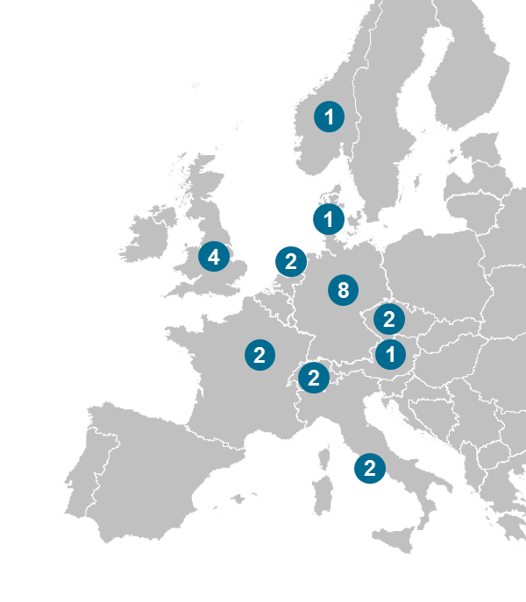
PRISMA Public Consultation
The questionnaire was sent to the then around 850 users (290 shippers) of the platform
25 companies, coming from different European and non-European countries, sent responses on the questionnaire
One European Association of Traders also took part in the consultation

Slide 12
Main Results of the Consultation Process
PRISMA website / Transparency & Usability:
  Users consider the PRISMA platform a secure tool to buy capacity
  Ease of navigation has been identified as a topic to be addressed by some users. PRISMA will internally evaluate how to improve this aspect.
Support
  The helpdesk was considered friendly and helpful in solving the user’s problems
  Some users suggested that it may be useful to extend the support hotline to 20:00. PRISMA will evaluate whether such an extension of the hotline times may be useful.
Communication
  The overall communication was well evaluated
GTCs
  The GTCs as well as the respective communication was considered good and no comments were raised asking for urgently needed improvements.

Slide 13
Back up

Slide 14
Number of Bundled Auctions that Ended with a Surcharge
Lasów
Zelzate
1
1
3
Oberkappel
Blaregnies/
Taisnières
1
4
53
Eynatten
Mendelsheim/
Obergailbach
Since the start of the PRISMA platform in April 2013, 63 out of 5,454 bundled auctions ended with a surcharge.
X
Number of concluded auctions with a surcharge
X
entry
X
exit

Slide 15
Number of Unbundled Auctions that Ended with a Surcharge
Ellund
Emden
Oude
Statenzijl
Drohne
13
3
1
1
Oberkappel
1
3
1
Überackern
2
3
1
Wallbach
Mendelsheim
Arnoldstein
Since the start of the PRISMA platform in April 2013, 29 out of 22,614 unbundled auctions ended with a surcharge.
X
Number of auctions with a surcharge (entry)
X
Number of auctions with a surcharge (exit)

Slide 16
Offered and allocated yearly capacities

Slide 17
Offered and allocated quarterly capacities
27.05.13
29.05.13
04.06.13

Slide 18
Offered and allocated month ahead capacities

Slide 19
Offered and allocated day ahead capacities

